Slide 1
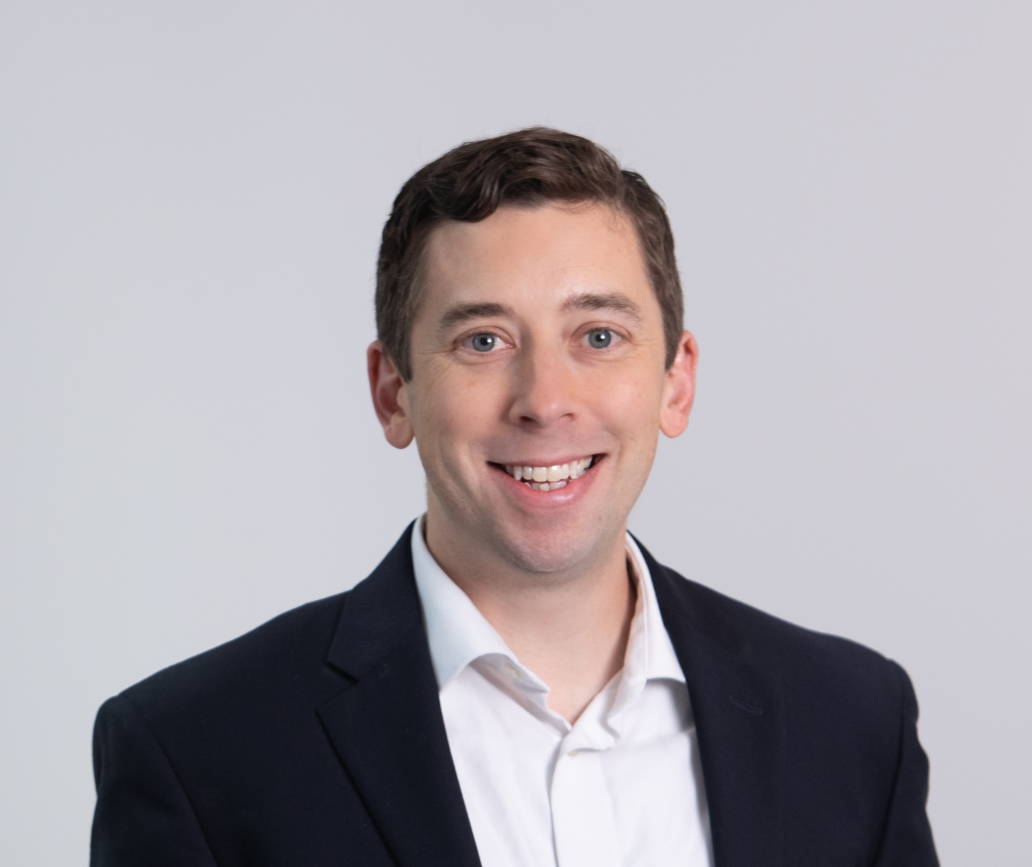
Bios
Matthew Haggerty
Director, Managed Technology Services
matthew.haggerty@rsmus.com
202 419 5104
Summary of experience
Matthew has over 12 years of finance and accounting experience, including working with nonprofit organizations ranging from $1 million to $300 million in annual revenues. He specializes in finance and accounting outsourcing with an emphasis on linking finance, operations and strategy. Matthew also serves as a senior analyst for RSM’s nonprofit and education industry, where he works with a number of clients and RSM economists to deliver a greater level of awareness, understanding and insight into the forces shaping the middle market.
Matthew’s experience spans a wide range of accounting, finance and operational services. He has experience working with a variety of accounting software’s, CRM platforms and HR information systems, and is proficient in board and management presentations and trainings.
In Matthew’s role as a senior analyst for the nonprofit and education industry, he works with a team of selected RSM colleagues to analyze market trends and develop thought leadership and related materials to support our clients and practitioners. This includes whitepapers, webinars and more to share insights and perspectives throughout the nonprofit and education community.
Prior to joining RSM, Matthew served as director of finance at a national education policy organization, vice president of finance and administration at a regional human services provider and chief operating officer at a local community development association.
Matthew actively volunteers in his community, including with his neighborhood community association and his church, and recently served on the board of directors for a local education advocacy organization.
Professional affiliations and credentials | Education
Sage Intacct, certified accounting specialist Bill.com, certified expert and guru | Master of Public Policy, public-nonprofit partnerships, George Washington University Bachelor of Business Administration, finance and economics, University of Notre Dame

